Slide 1

Dental Cavity Detection using Deep Learning (CNN)
230031388 Munaga Ramya

Slide 2
Contents
Introduction
Problem Statements
Data Set’s Used
Models used
Outcome
Conclusion

Slide 3
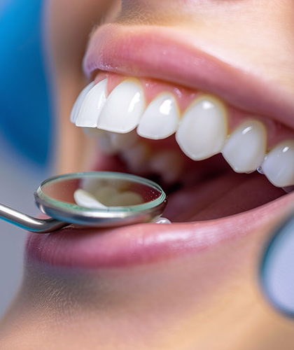
Introduction
A dental Cavity is a damaged area on the tooth surface caused by bacteria, acids and poor hygiene
So, Early detection of the Dental cavity helps in preventing the serious dental Problems
To prevent the Dental Cavity, our Project implement CNN to automatically classify teeth as Healthy or Cavity, providing faster and more accurate diagnosis support.

Slide 4
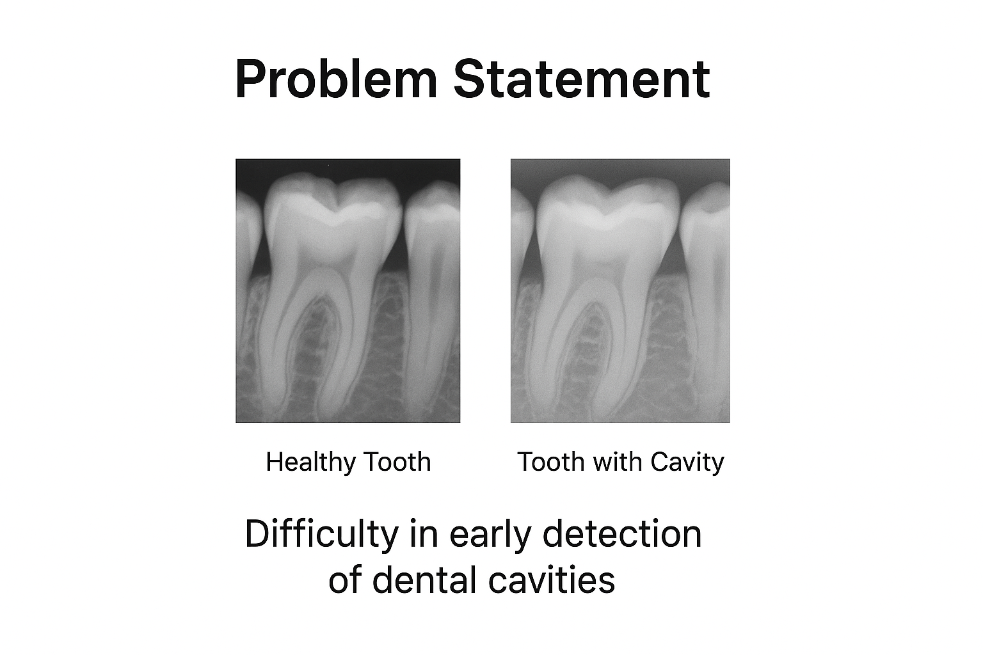
Dental cavities are often detected late, leading to severe oral health issues. Manual diagnosis through X-rays or visual inspection can be time-consuming and may vary by dentist’s expertise. There is a need for an automated system that can detect cavities early and accurately from dental images.

Slide 5
Existing Systems VS Proposed System
Existing Systems (Previous Approaches)
Proposed System (CNN-based)
Manual Analysis: Dentists examine X-rays visually slow, error-prone, subjective.
Traditional Image Processing: Thresholding, edge detection, segmentation limited accuracy, sensitive to noise, struggles with subtle cavities.
Classical ML Models: SVM, Random Forest with handcrafted features → require feature engineering, lower generalization on diverse datasets.
Learns features automatically from X-ray images no manual feature engineering.
Achieves higher accuracy and consistency in detecting cavities.
Handles subtle variations and noisy images better. Supports early diagnosis and reduces human workload.

Slide 6
DataSet’s used
The dataset used in this project is taken from Kaggle (Dental Cavity Detection Dataset).
Here Images are classified into 2 classes 1. Healthy
2. Cavity
The dataset contains over 2000 images, which are divided into training, validation, and testing sets.
This dataset is used to train the CNN model so that it can learn to differentiate between healthy and decayed teeth effectively.

Slide 7
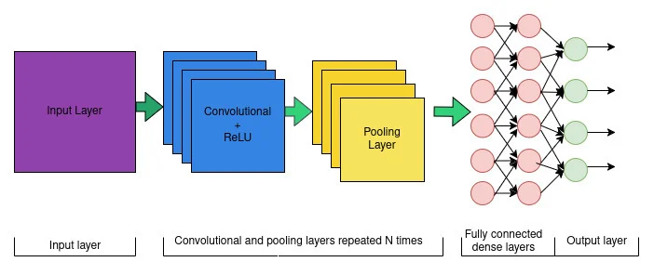
New Models Used
Convolutional Neural Network (CNN) was used to classify dental images into Cavity and Healthy categories.
The CNN automatically extracts important visual features like edges, textures, and patterns from tooth X-rays.
It consists of convolutional + pooling layers for feature extraction, followed by fully connected layers for decision-making.
The final output layer predicts the probability of a tooth being cavity or healthy.

Slide 8

Code implementation

Slide 9


Slide 10


Slide 11


Slide 12
Outcomes / Results
The CNN model accurately classifies dental images as Healthy or Cavity.
Achieved high accuracy (e.g., ~90%+, depending on training results).
Successfully assists in early detection of cavities, reducing manual diagnosis time.
Provides a foundation for a supportive tool for dentists, enhancing diagnostic efficiency.

Slide 13
Conclusion
Our CNN model efficiently analyzes dental X-ray images, accurately identifying cavities and differentiating them from healthy teeth. This automated detection system not only speeds up the diagnostic process for dentists but also reduces human error, ensuring reliable results. By enabling early diagnosis, it helps prevent severe dental complications, supports proactive treatment planning, and promotes overall oral health. Integrating AI in dental care demonstrates the potential of technology to enhance patient outcomes and optimize clinical workflows

